Slide 1
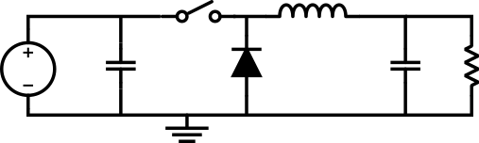
Buck Converter Nonidealities
and their Influence on Design:
Presented by:
Michael McGarty

Slide 2
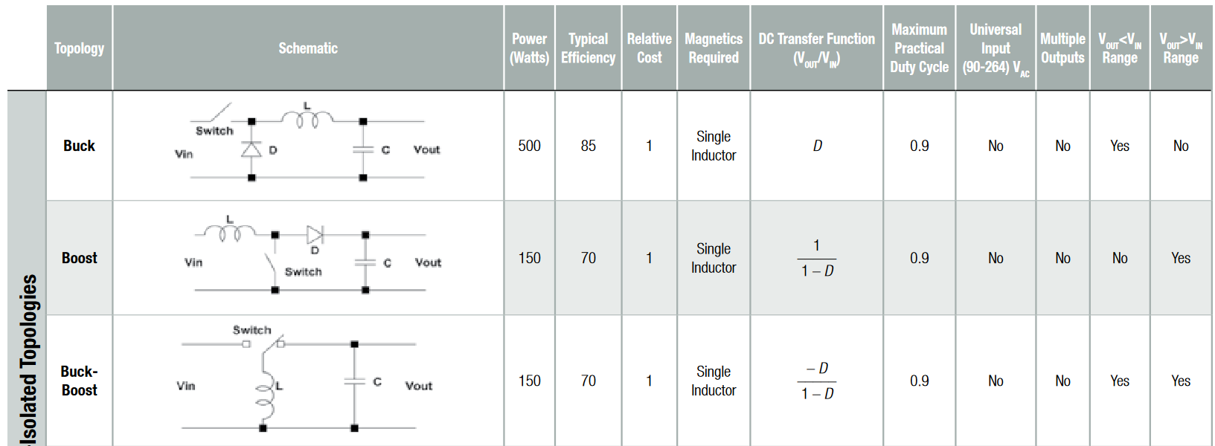
Motivation:

Slide 3
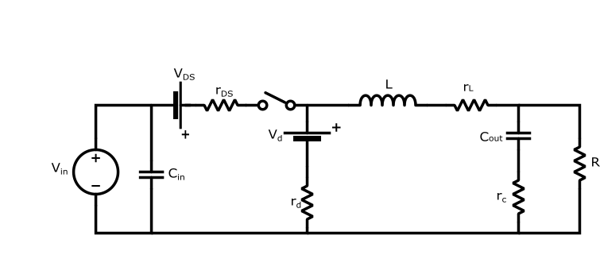
Types of nonidealities:
The six standard nonidealities:
Inductor Series Resistance
Output Capacitor ESR
Diode Forward Voltage
Diode On-resistance
Switch On-voltage
Switch On-resistance
Notes:
The ideal buck converter design is relatively straight forward under ideal conditions. However, introducing each of the following nonidealities greatly increases the mathematical analysis.

Slide 4
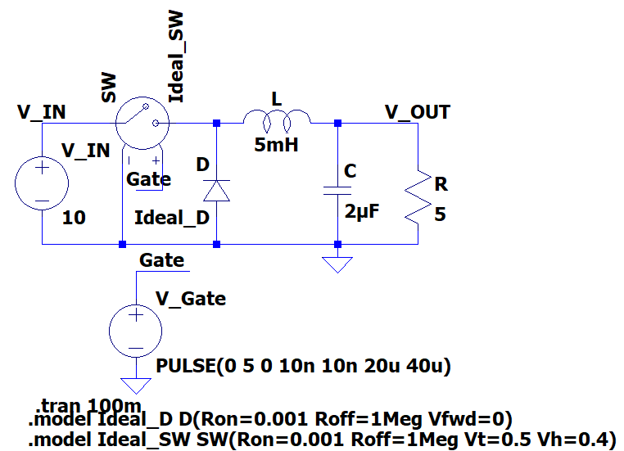
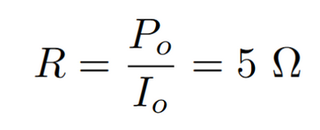
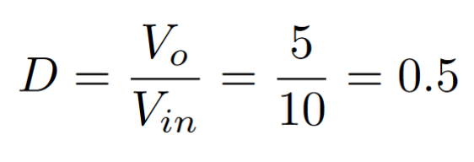
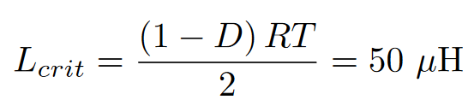
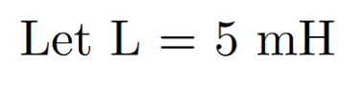
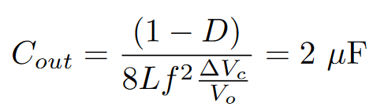
Ideal Buck Design
Assuming ideal components, design a 10 to 5 V buck converter that can supply 5 Watts. The supply should have a maximum current and voltage ripple of 5% and 1%, respectively. Assume f = 25 kHz.

Slide 5
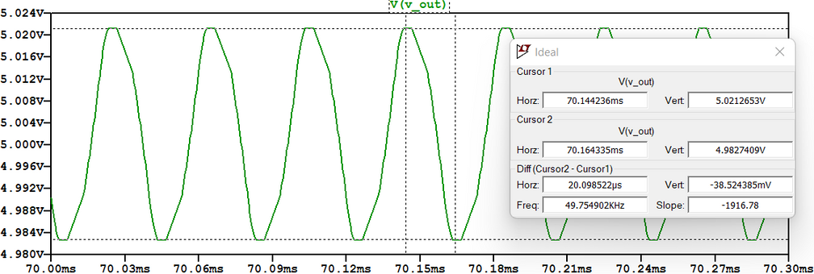
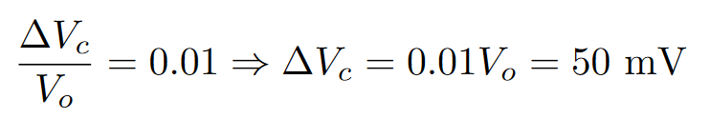
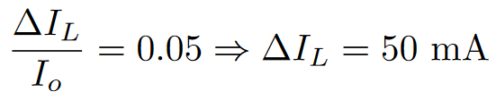
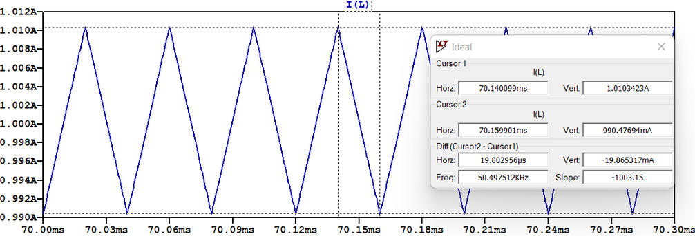
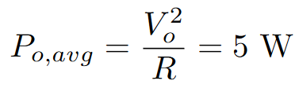
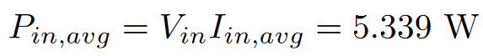
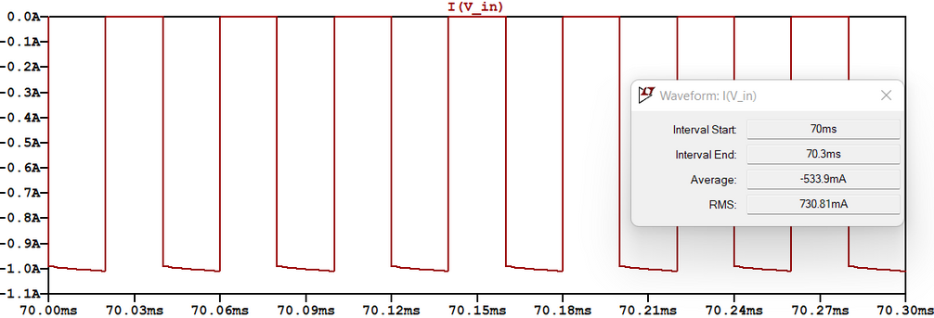
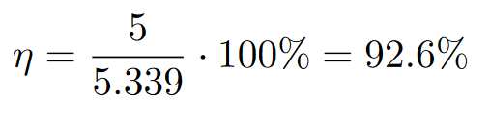
Ideal Waveforms:

Slide 6
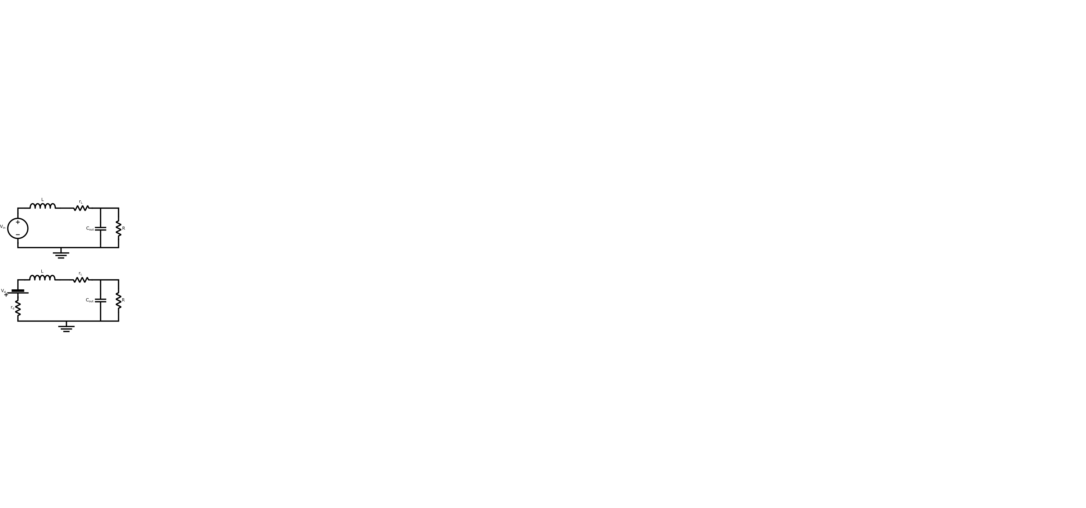
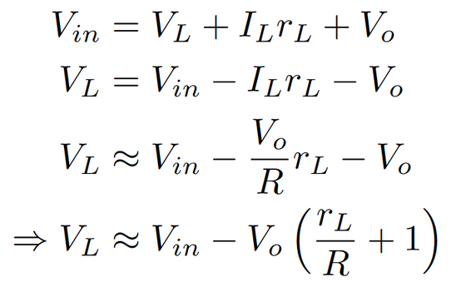
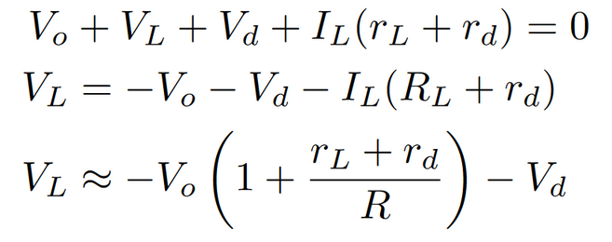
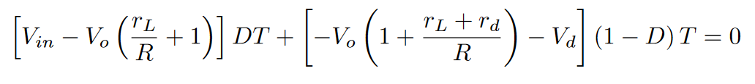
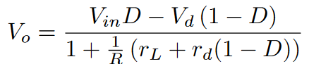
Methodology:
Mode 1:
Mode 2:
Using the volt-second balance,

Slide 7
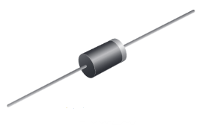
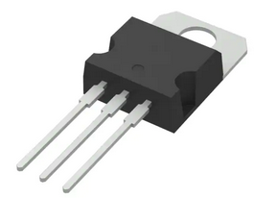
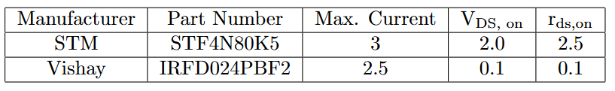
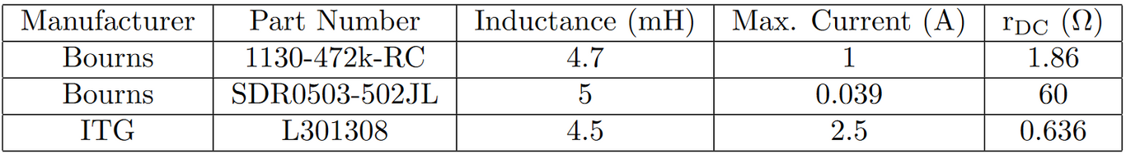
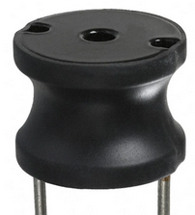
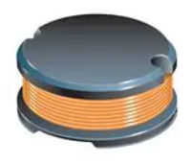
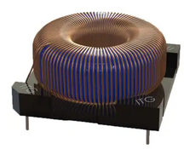
Sample Components
Diodes:
MOSFETs:
Inductors:
[4] Component images courtesy of DigiKey.

Slide 8
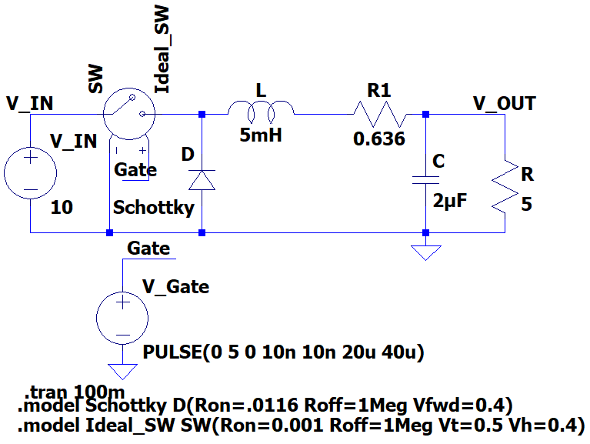
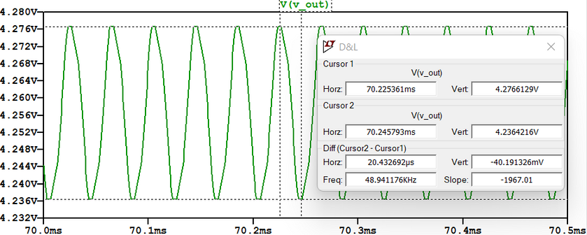
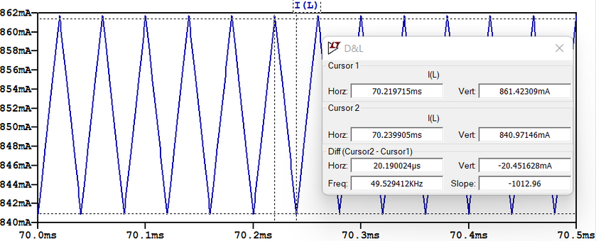
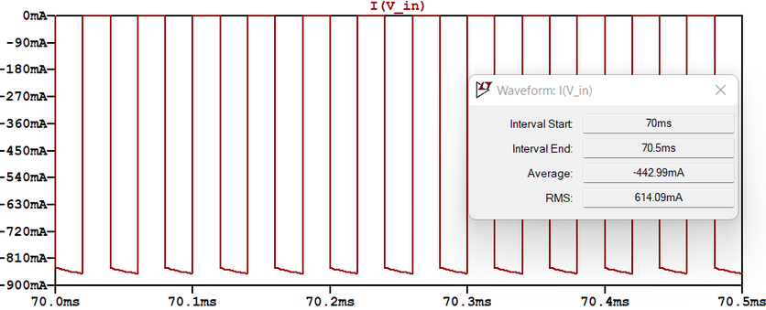
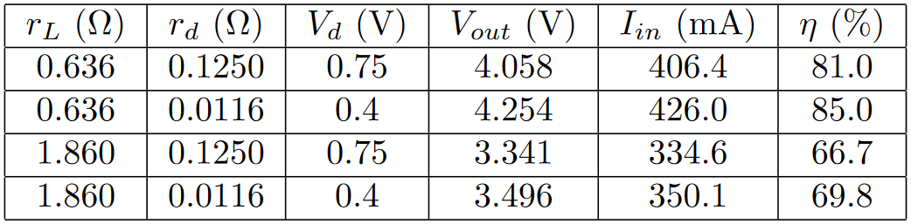
Example Losses
High and Low resistance inductors with
Silicon and Schottky Diodes:

Slide 9
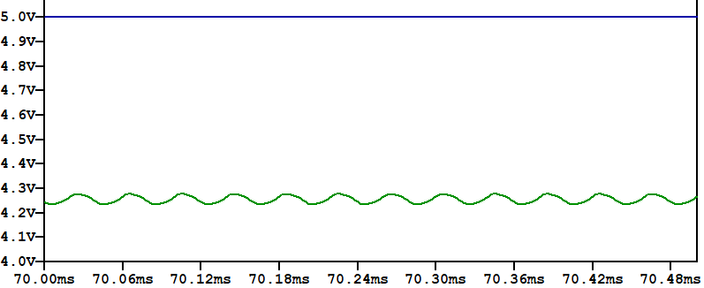
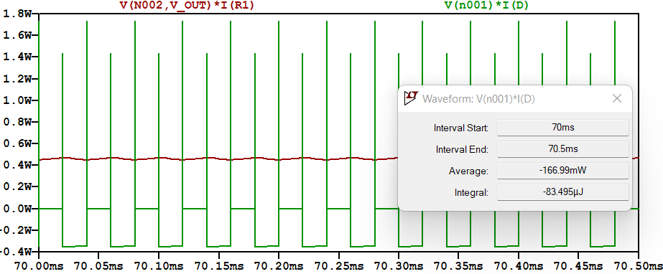
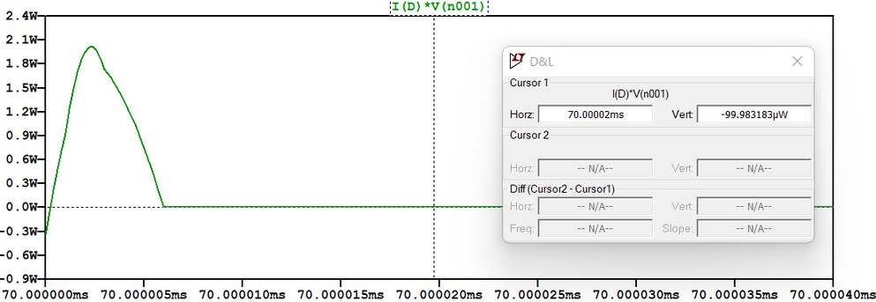
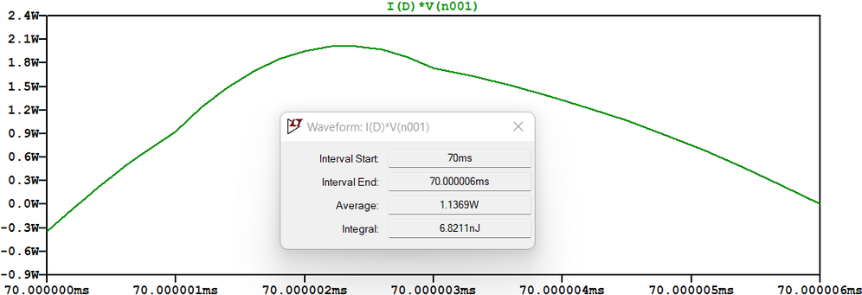
Additional Waveforms

Slide 10

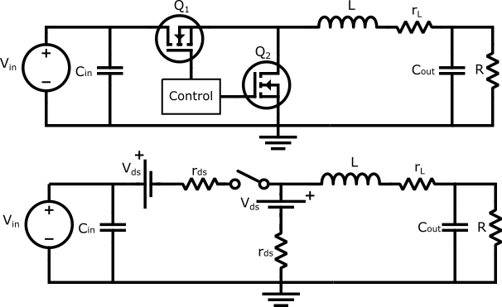
Synchronous Buck Topology

Slide 11
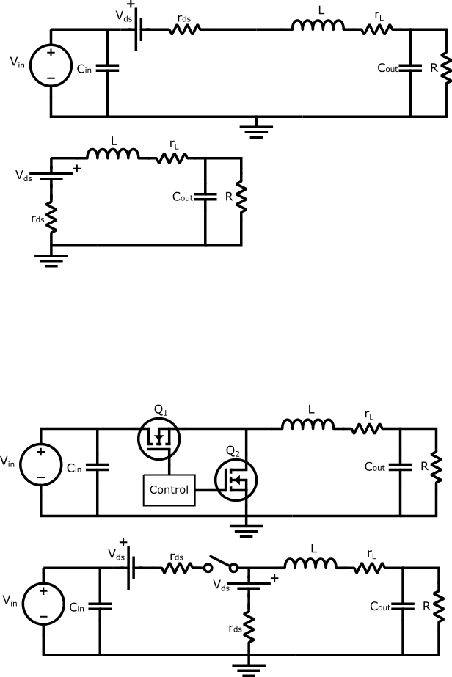
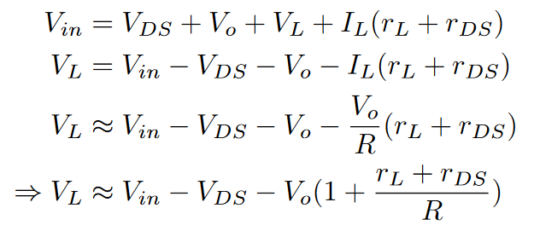
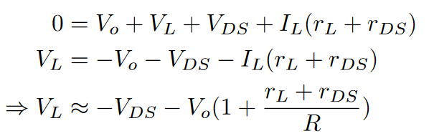
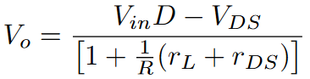
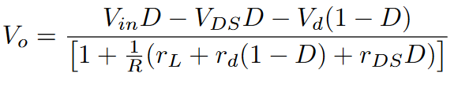
Gain Derivation:
Using the volt-second balance,,
Identical switch equation:
Switch and diode equation:

Slide 12
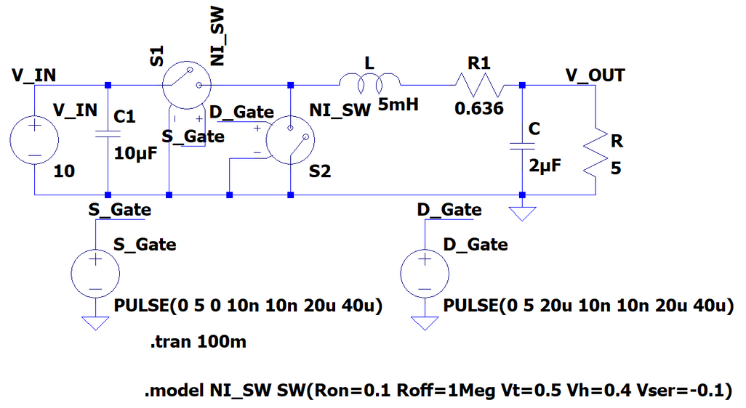
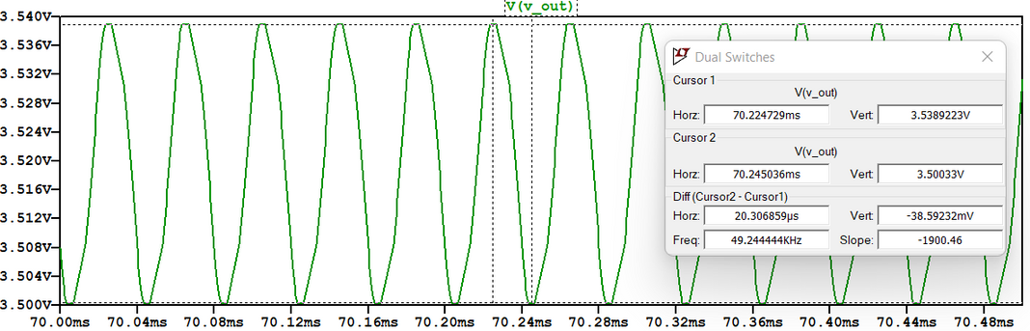
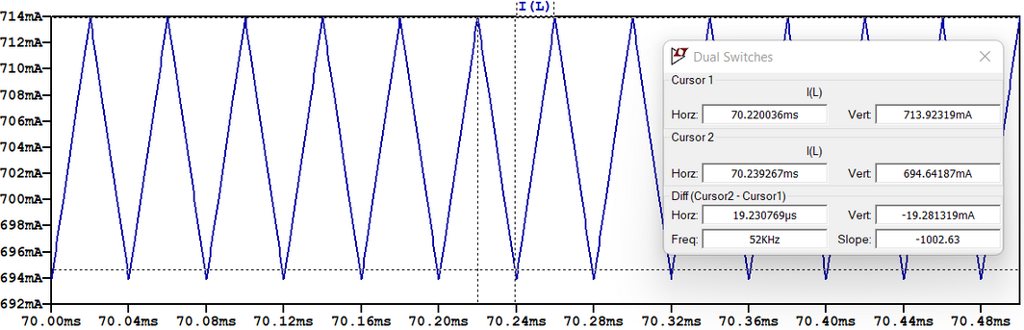
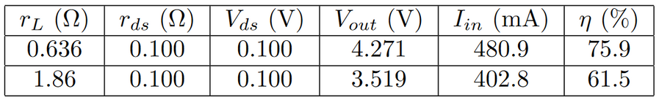
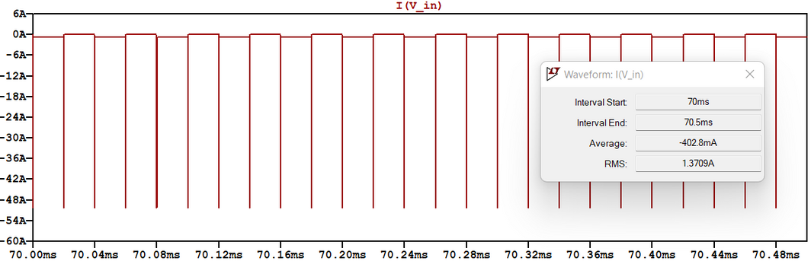
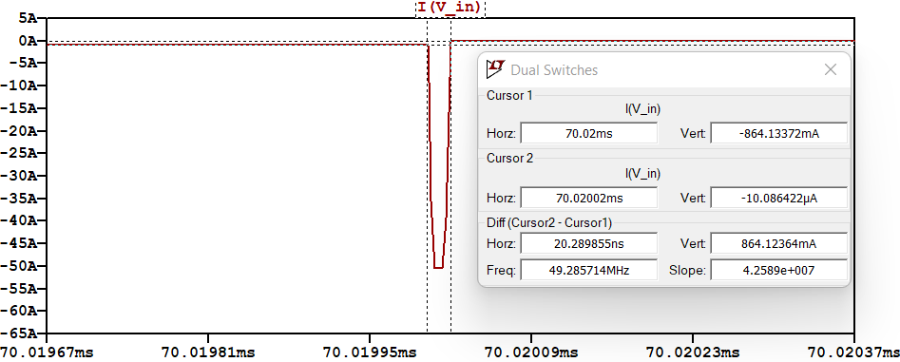
Synchronous Waveforms

Slide 13
References:
[1] SMPS Topology Chart - Wurth Electroniks https://www.we-online.com/web/fr/index.php/show/media/07_electronic_components/news_1/blog/midcom_blog_photos/SMPSChart.pdf
[2] AND9135/D LC Selection Guide for the DC-DC Synchronous Buck - onsemi https://www.onsemi.com/pub/Collateral/AND9135-D.PDF
[3] Batarseh, I., & Harb, A. (2019). Power Electronics: Circuit Analysis and Design. Springer.
[4] Component Figures:
Vishay 1N5400 - https://www.vishay.com/ppg?88516
Vishay 1N5822 - https://www.vishay.com/diodes/list/product-88526/
STM STF4n80k5 - https://www.st.com/en/power-transistors/stf4n90k5.html
IRFD024PBF2 - https://www.vishay.com/mosfets/list/product-91126/
Bourns 1130-472k-RC - https://www.bourns.com/data/global/pdfs/1130_series.pdf
Bourns SDR0503-503JL - https://www.bourns.com/docs/product-datasheets/sdr0503.pdf
ITG 301308 - https://www.itg-electronics.com/series/747

